Slide 1


Relevance Vector Machines Lecture Based on C. Bishops Textbook
Machine Learning – Spring 2018
Paul Gader

Slide 2
Relevance Vector Machine
Bayesian Linear Regression
Gaussian Likelihood and Prior
Sparsity Achieved with Prior Hyper-Parameters
Bayesian Linear Regression with Kernels

Slide 3
RVM: Linear Regression (not fully general)
Linear Model
Likelihood Function

Slide 4
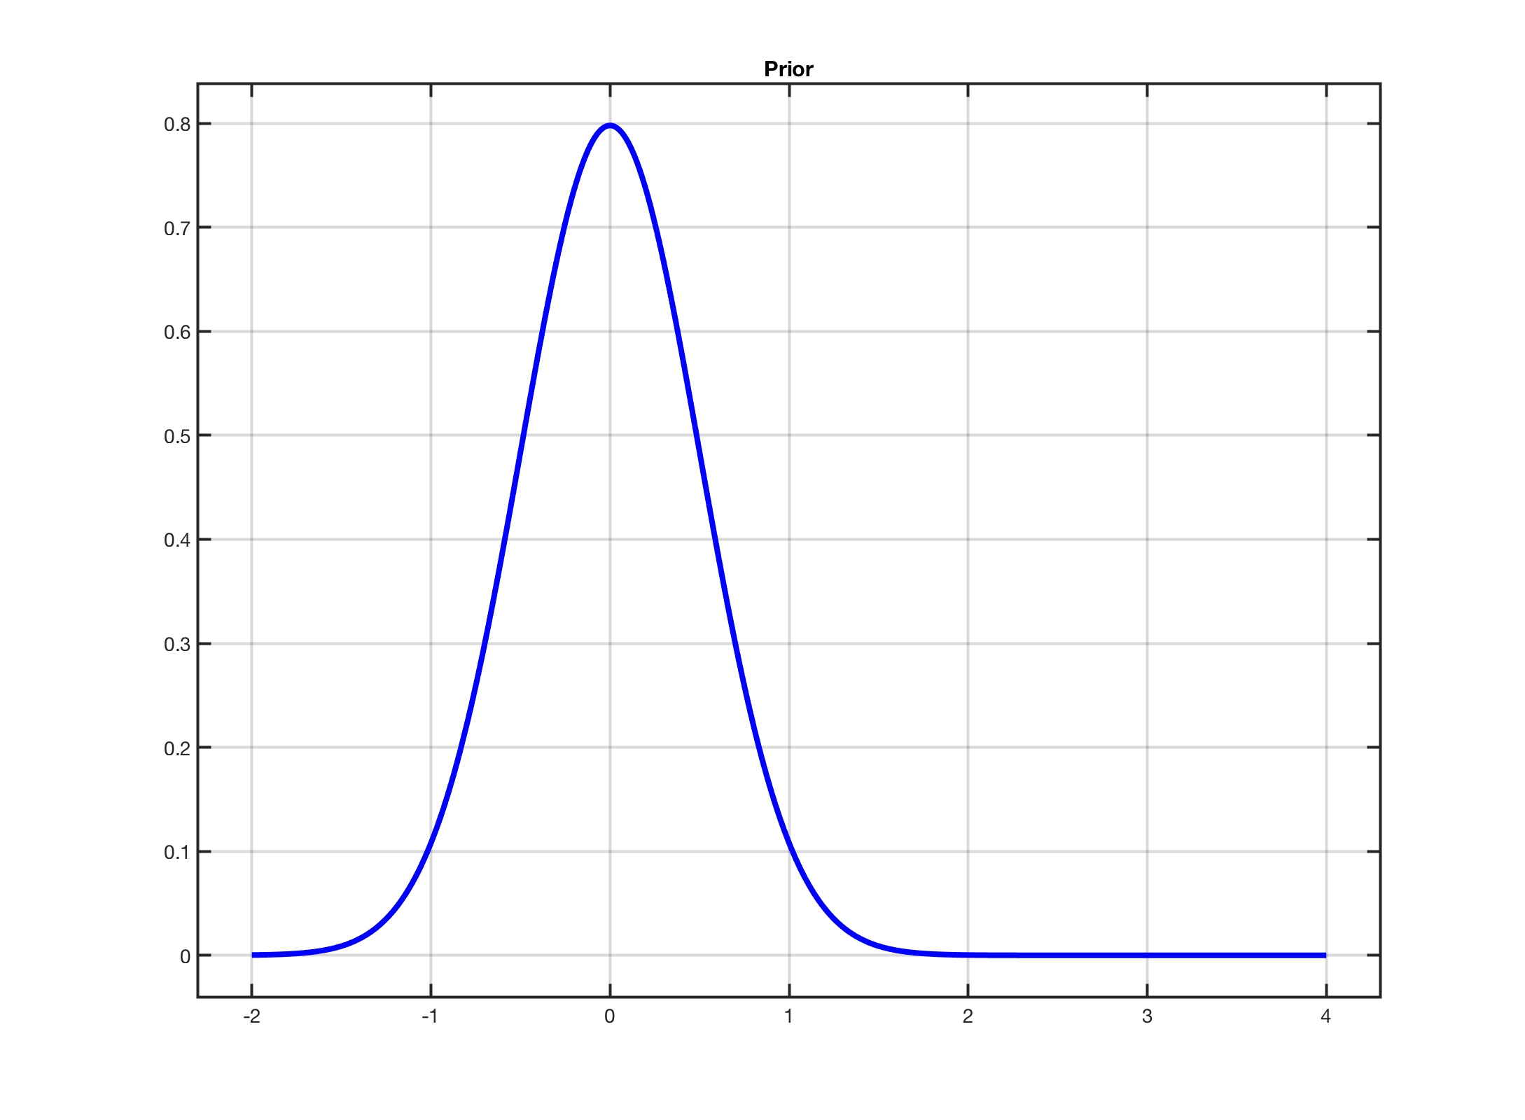
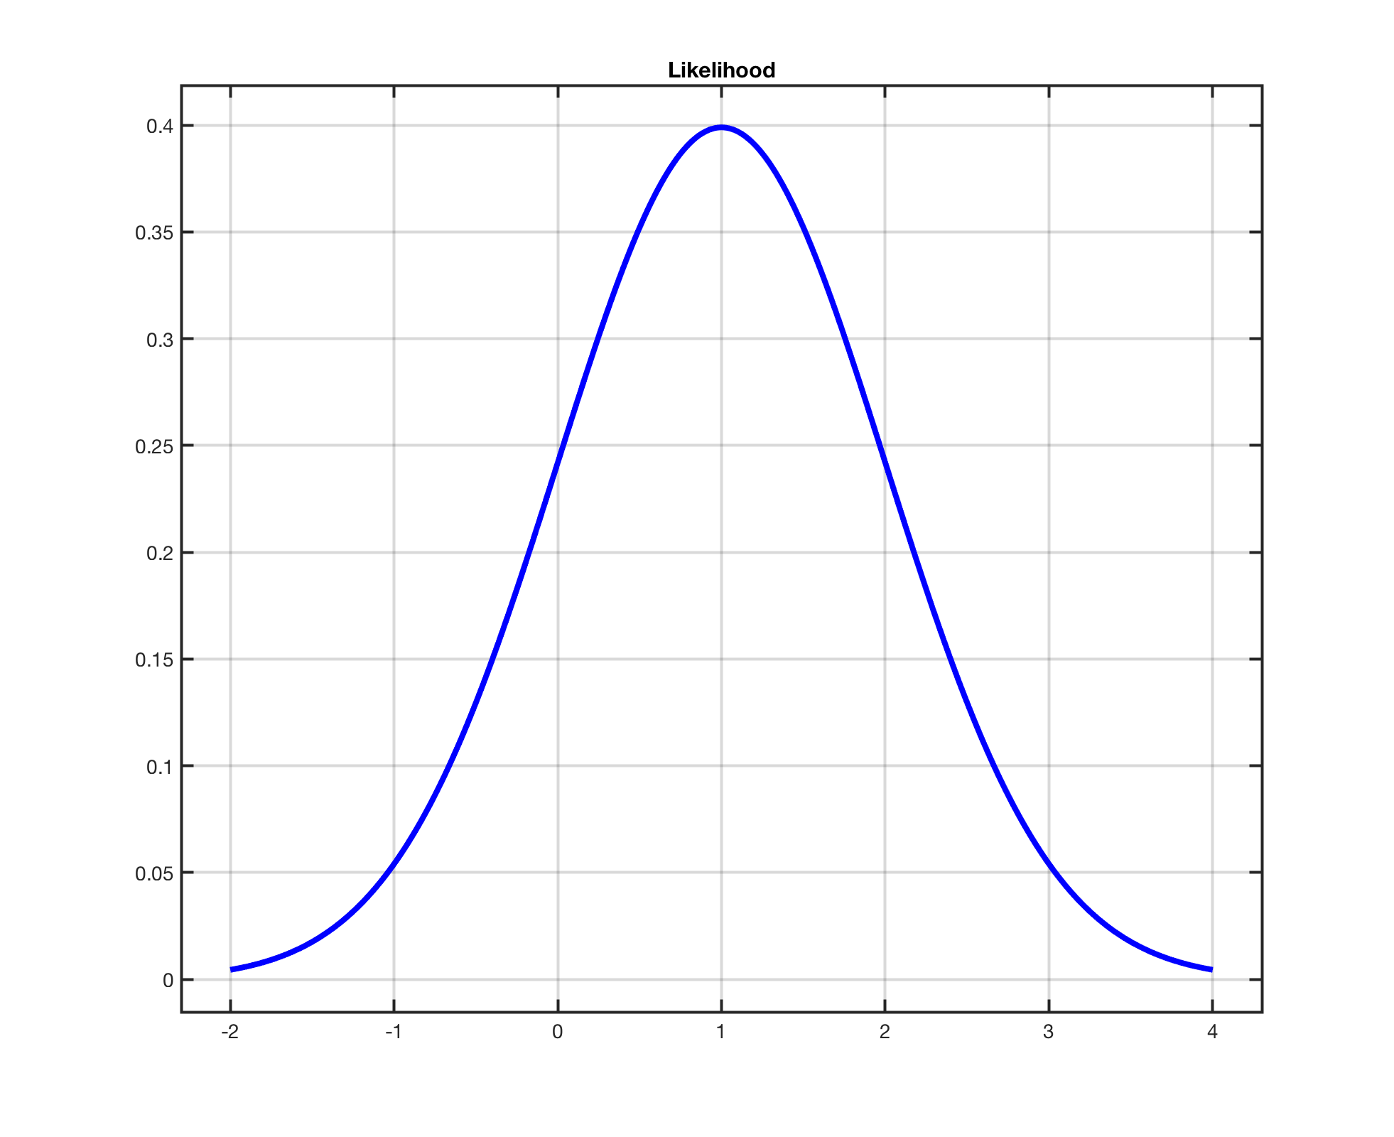
RVM: Bayesian Linear Regression
Gaussian Likelihood and Prior

Slide 5
RVM – Bayesian Linear Regression 2D
Likelihood
Prior

Slide 6
Posterior Facts
Does this look familiar if A = αI ?

Slide 7
RVM: Bayes Linear Regression with Kernels

Slide 8
RVM: Use Kernels

Slide 9
RVM with Kernels: Hyperparameter Learning

Slide 10
RVM and Sparsity
Suppose alpha_d is negative with a large absolute value
Then alpha_d^{new} is a large positive value

Slide 11
Simple Example

